Slide 1
Towards Connectivity-Aware Deployment and Adjustment for Roadside Units
Jiafeng Hu, Beihong Jin, Fusang Zhang, Zhaoyang Wang and Yuwei Yang
Institute of Software, Chinese Academy of Sciences
Nov. 14, 2013

Slide 2
Outline
Background
1
Volans
2
Evaluation
3
Conclusion
4

Slide 3
Outline
Background
1
Volans
2
Evaluation
3
Conclusions
4

Slide 4
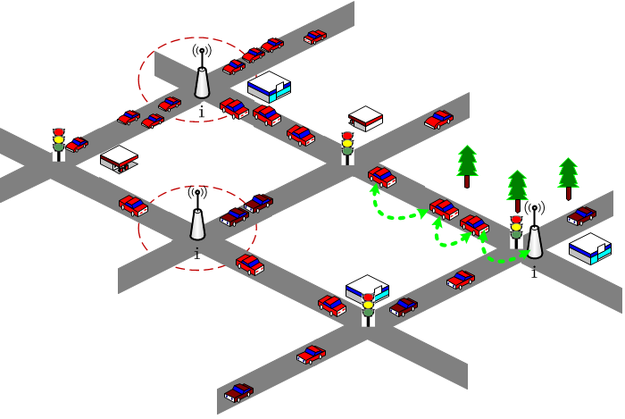
Background
VAENTs( Vehicular Ad hoc Networks)
Mobile Ad hoc Networks
Vehicle
Roadside Unit
Notes:
This is a picture of Vehicular Ad hoc Networks, we call it VANETs in brief.

Slide 5
Background
VAENTs( Vehicular Ad hoc Networks)
Mobile Ad hoc Networks
Vehicle
Roadside Unit (RSU)
Notes:
VANETs are a kind of mobile and self-organizing network built over two types of nodes, that is, the vehicle nodes and the Roadside Unit(RSU) nodes.
RSU nodes are almost stationary, which can be fixed on certain points along the roads, and also can be moved from one place to another if necessary.

Slide 6
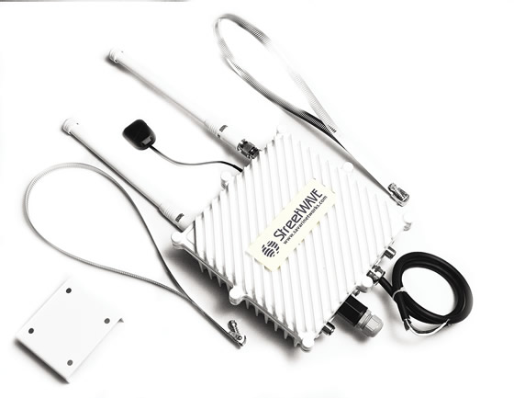
Introduction of RSU
Temporally store and relay data
Gateways to the Internet
Channel coordination and access in MAC layer
Notes:
RSU has three main functions.
First, it can temporally store and relay data
Second, sometimes, the RSUs are used as gateways to the Internet
In addition, RSU also assist in channel coordination and access in the MAC layer

Slide 7
Introduction of RSU
Temporally store and relay data
Gateways to the Internet
Channel coordination and access in MAC layer
Tradeoff between the RSU deployment (including number and location) and the performance of VANETs
Notes:
Obviously, the more functions RSU has, the more important the RSU deployment is. However, as far as costs are concerned, it is unrealistic to deploy a large number of RSUs along the roads. Therefore, there is a tradeoff between the RSU deployment and the performance of VANETs.

Slide 8
Challenges in RSU Deployment
No theoretical model
Intrinsic complexity of road networks
Vehicle behaviors
Huge solution space
possible combination
Topology of road networks
Vehicle trajectories, speeds and densities
Data routing
Application scenarios
Notes:
To date, it has been still a challenge to propose an ideal RSU layout for urban scenarios.
First, no theoretical model to analyze and evaluate the performance brought by different RSU deployment, because of the intrinsic complexity of road networks and vehicle behaviors.
Second, the solution space for practical deployment is huge.
the deployment of RSUs is related with various factors, including a large number of possible combination of RSU locations, the topology of road networks, vehicle trajectories, and so on, All of these factors affect the size of solution space.

Slide 9
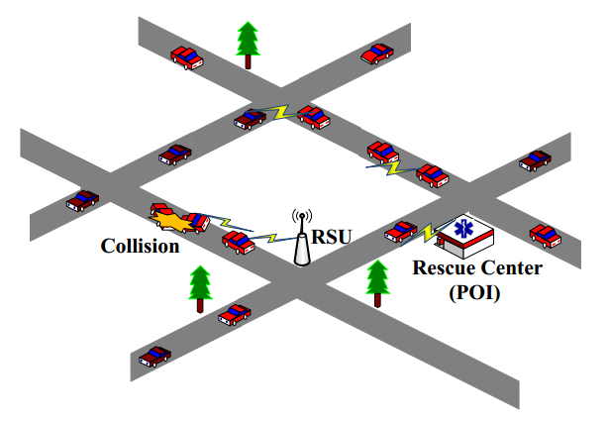
Motivation
POI (Point of Interest) -related applications
Notes:
We note that the POIs( Points of interest) are often occurred in the VANET applications for urban scenarios where the interaction between vehicles and POIs is frequent. For example, an accident happens at someplace, then vehicles nearby need to deliver the accident message to the traffic rescue center over a VANET, where the rescue center is a POI. The POIs will evolve over time, some places may not be POIs anymore and some may become the new ones. Up to now, although some RSU deployment strategies have been proposed for different applications, there is no POI-related RSU deployment strategy.

Slide 10
Motivation
POI (Point of Interest) -related applications
Improve the performance of such interaction
Notes:
What we want to do is optimizing RSU deployment and adjustment to improve the performance of such interaction.

Slide 11
Motivation
POI (Point of Interest) -related applications
Improve the performance of such interaction
Volans, a connectivity-aware approach to RSU deployment and adjustment for POI-related applications
Notes:
In this paper, we present a connectivity-aware approach to RSU deployment and adjustment for POI-related applications.
In our group, we always name our work by different constellations, so that in this work, we call our approach Volans.

Slide 12
Contributions
Analyze vehicle trajectories to obtain the connectivity status of a VANET
Two efficient strategies
Stepwise strategy
Greedy strategy
Support both RSU deployment and adjustment
Notes:
Compared with existing work, our work has the following contributions:
First it is the first work that using vehicle trajectories data to reflect the connectivity status of a VANET and making use of those data to guide RSU deployment.
Besides, Volans gives two efficient deployment strategies: stepwise strategy and greedy strategy.
In addition, Volans can Support both RSU deployment and adjustment.

Slide 13
Outline
Background
1
Volans
2
Evaluation
3
Conclusions
4
Notes:
Now, let me introduce Volans to you in detail.

Slide 14
Assumptions
Vehicles and RSUs are equipped with GPS, digital maps, and the locations of POIs
The trajectories of vehicles can be collected effectively
Notes:
We assume that vehicles and RSUs are equipped with GPS receivers, digital maps, and they all can get the locations of POIs.
Meanwhile, the trajectories of vehicles can be collected effectively.

Slide 15
Problem Formulation
Construct a weighted undirected graph G(V, E) for the VANET
Each intersection is mapped to a vertex in the set V
Each vertex v_{i} is a tuple in the form of < loc, rsu >
v_{i}.loc is the location of v_{i}
v_{i}.rsu is a Boolean variable that 1 means there is an RSU at v_{i}
Each road segment is mapped to an edge in the set E
Notes:
In this problem, we construct a weighted undirected graph G for the VANET.
Each intersection is mapped to a vertex in the set V
Every vertex v_{i} is a tuple which consists of the vertex’s location and a Boolean variable that 1 means there is an RSU at this vertex, 0 means there is no RSU.
Each road segment is mapped to an edge in the set E

Slide 16
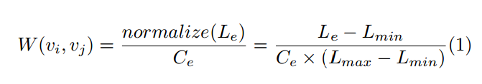
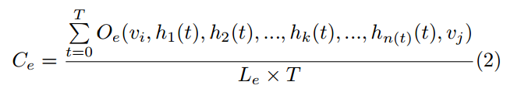
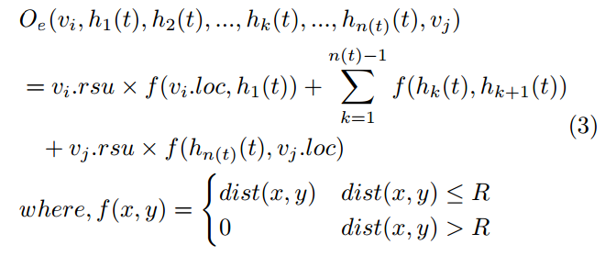
Problem Formulation
The weight of edge e(v_{i}, v_{j})
C_{e}: the average transmission distance ratio
O_{e}(): transmission distance on edge e
Notes:
Now, we define the weight of edge as follows,
It consists of Le and Ce.
Le is the length of edge e, and Ce is the average transmission distance ratio, Ce can be calculated as follows:
Here, T is the whole observation period and function Oe() calculate transmission distance on edge e.

Slide 17
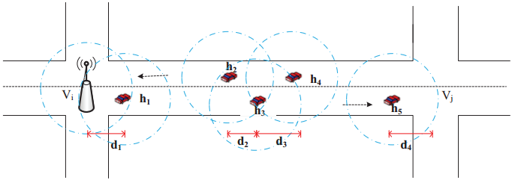
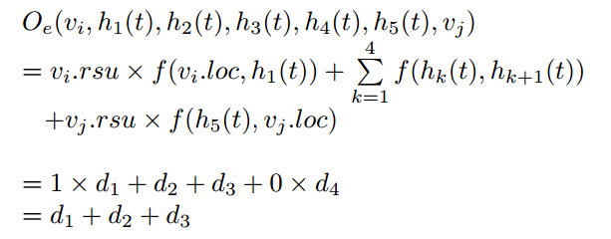
Example of O_{e}()
Notes:
This is an example of how to calculate function Oe().
As shown in this figure, at time point t, there are 5 vehicles on edge from vi to vj, denoted as h1 to h5 respectively. V_{i}.rsu equals 1 because there is an RSU at vi, while vj.rsu equals 0. Thus, the transmission distance can be calculated as follows:

Slide 18
Problem Formulation
Notes:
After we calculate the weights for all the edges, we get the weighted graph G. The weight of edge e reflects the delay of the road segment corresponding to e, which indicates the VANET connectivity status on that road segment.
The average transmission distance ratio on edge will increase after deploying an RSU at one vertex of that edge, so that its weight will decrease.

Slide 19
Problem Formulation
According to the existing work[1], only intersections are our candidate locations for the deployment of RSUs.
[1]Trullols, O., et. al. (2010), ‘Planning Roadside Infrastructure for Information Dissemination in Intelligent Transportation Systems’, Computer Communications, Vol. 33, No. 4, pp.432–442.
Notes:
According to the existing work, only intersections are our candidate locations for the deployment of RSUs.

Slide 20
Problem Formulation
According to the existing work[1], only intersections are our candidate locations for the deployment of RSUs.
The problem of selecting r intersections from all intersections to deploy RSUs can be converted into selecting r vertexes from set V of graph G
The selection criteria and the optimization goal may be diﬀerent, depending on diﬀerent applications
[1]Trullols, O., et. al. (2010), ‘Planning Roadside Infrastructure for Information Dissemination in Intelligent Transportation Systems’, Computer Communications, Vol. 33, No. 4, pp.432–442.
Notes:
The problem of selecting r intersections from all intersections to deploy RSUs can be converted into selecting r vertexes from set V of graph G.
The selection criteria [kraɪ'tɪərɪə] and the optimization goal may be different, depending on different applications
As I mentioned above, we focus on those POI-related applications. For the sake of simplicity, the POIs are supposed to have the same popularity and are located at the intersections. Moreover, the messages are permitted to be sent anytime, anywhere from any vehicle to any POI.

Slide 21
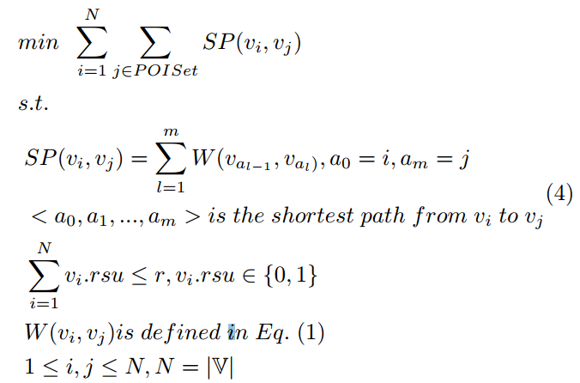
Stepwise Strategy
RSU Deployment Optimization Problem (RDOP)
Optimization goal
Select r vertexes to deploy RSUs
minimize the sum of the weights on edges in the shortest paths from each vertex to each POI
Notes:
Based on graph G, we propose two strategies, including stepwise strategy and greedy strategy.
The first strategy is stepwise strategy, we formulate the RSU deployment problem as a binary integer programming problem, named RSU Deployment Optimization Problem (RDOP in short).
The optimization goal is that, select r vertexes to deploy RSUs and minimize the sum of the weights on edges in the shortest paths from each vertex to each POI.

Slide 22
Stepwise Strategy
RSU Deployment Optimization Problem (RDOP)
Optimization goal
Select r vertexes to deploy RSUs
minimize the sum of the weights on edges in the shortest paths from each vertex to each POI
The RDOP is NP-hard because it can be proved to be a generalization of the Set Cover Problem (a well-known NP-hard problem)
Notes:
The RDOP is NP-hard because it can be proved to be a generalization of the Set Cover Problem, which is a well-known NP-hard problem.

Slide 23
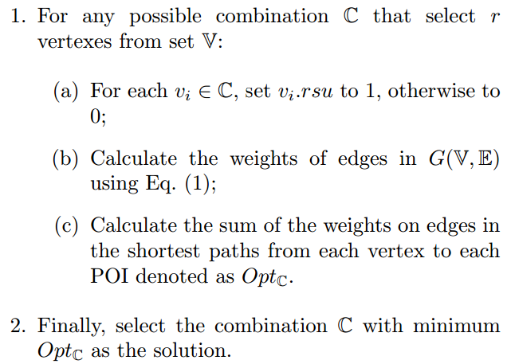
Stepwise Strategy
Naïve_search(V, r)
Notes:
When the solution space of RDOP is small, it can be solved using naive search method within a tolerable running time. The naive search method can be described as follows:

Slide 24
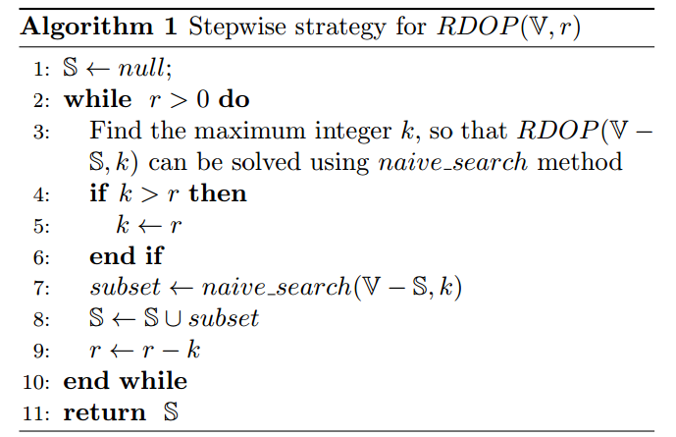
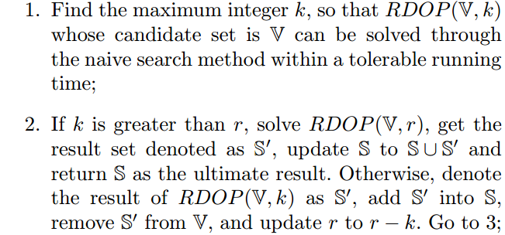

Stepwise Strategy
V denote the candidate vertex set
r is the number of RSUs needed to be deployed
S is the resultant vertex set
Notes:
However, in general, the solution space of RDOP is very huge. Therefore, we design a heuristic algorithm, named stepwise strategy.
In this strategy, we invoke naïve search function iteratively. Algorithm 1 is the pseudo-code of stepwise strategy.

Slide 25
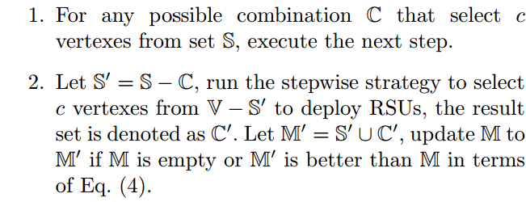
Stepwise-Based Adjustment (SBA)
V denote the candidate vertex set
S is the set of all the RSUs which have been already deployed
c is the number of RSUs needed to be adjusted
M is the resultant set of vertexes
Notes:
When the newest trajectories data are obtained or POIs are updated, we have to adjust the positions of RSUs correspondingly. Based on the stepwise strategy, we design an RSU adjustment strategy named SBA.
For any possible combination that select c vertexes from set S, run the stepwise strategy. At last we select the optimal scheme.

Slide 26
Stepwise-Based Adjustment (SBA)
V denote the candidate vertex set
S is the set of all the RSUs which have been already deployed
c is the number of RSUs needed to be adjusted
M is the resultant set of vertexes
SBA is feasible because in a realistic large-scale urban area a relatively small number of RSUs suﬃce[2]
[2]Wu, Y., Zhu, Y. and Li, B. (2012) ‘Infrastructure-Assisted Routing in Vehicular Networks’, Proceedings of IEEE INFOCOM 2012, pp.1485–1493
Notes:
SBA is feasible because in a realistic large-scale urban area a relatively small number of RSUs suffice [sə'faɪs].

Slide 27
Greedy Strategy
Notes:
We consider while an RSU is placed on a vertex, the weights of its adjacent edges should be reduced. In the meantime, the nearer the location of an RSU is to a POI, the more important role it will take on, since the data will be transferred to the POI eventually. After balancing the tradeoff between these two factors and the performance of data delivery, we design a greedy strategy for RSU deployment, named greedy strategy.

Slide 28
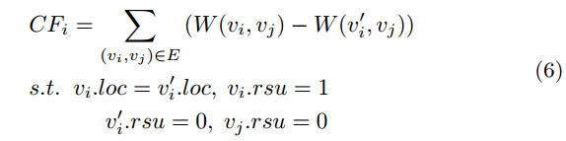

Greedy Strategy
The priority q_{i} for vertexes v_{i} in G(V, E) is as follows:
CF_{i} (Connectivity Factor) is the weight shift of v_{i}’s adjacent edges after an RSU is placed at v_{i}
DF_{i} (Distance Factor) is the distance factor between v_{i} and each POI
α is the weight factor
Notes:
In this strategy, each vertex has a priority based on its connectivity factor and distance factor. It can be calculated as follows:
Here, CFi (Connectivity Factor) is the weight shift of vi’s adjacent edges after an RSU is placed at vi, and DFi (Distance Factor) is the distance factor between vi and each POI, α is the weight factor

Slide 29
Greedy Strategy
The priority q_{i} for vertexes v_{i} in G(V, E) as follows:
CF_{i} (Connectivity Factor) is the weight shift of v_{i}’s adjacent edges after an RSU is placed at v_{i}
DF_{i} (Distance Factor) is the distance factor between v_{i} and each POI
α is the weight factor
Take the top r vertexes from the sorted list to place RSUs
Notes:
After getting the list of vertexes ranked by its priority, we just take the top r vertexes from the list to place RSUs.

Slide 30
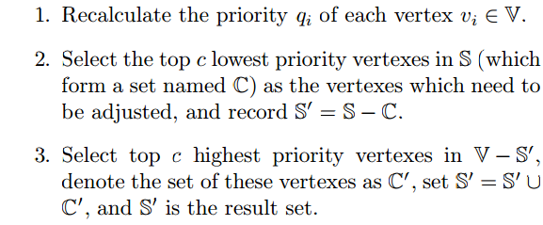
Greedy-Based Adjustment (GBA)
c RSUs from S need to be adjusted, the steps are as follows:
Notes:
Similarly, based on the greedy strategy, we design an RSU adjustment strategy named GBA.

Slide 31
Outline
Background
1
Volans
2
Evaluation
3
Conclusion
4
Notes:
Now, I will show you our performance evaluation results compared with the benchmark solution.

Slide 32
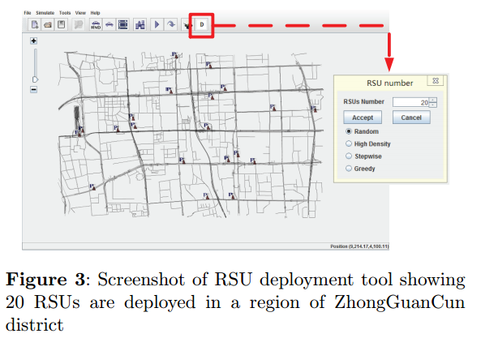
RSU Deployment Tool
Based on an open source tool CityMob for Roadmaps (C4R)
Random
High Density
Stepwise
Greedy
A. Before adjustment
B. After adjustment
Notes:
We build an RSU deployment tool whose GUI is shown in Figure 3. This tool is built based on an open source tool CityMob for Roadmaps.
We implement four strategies to deploy RSU. They are Random, High Density, stepwise and greedy strategy.
Figure 3 shows the result that 20 RSUs are deployed with random strategy in a region of ZhongGuanCun district, Beijing

Slide 33
Experimental Setup
Metrics
Delivery ratio
A ratio of the number of messages received by POIs to the number of messages sent by vehicles
Delivery delay
The duration from the moment when a message is sent from some vehicle to the moment when it is delivered to the destination POI
Comparison strategies
Random strategy
High density strategy
Choose intersections with higher traﬃc densities to deploy RSUs
Notes:
Our metrics are delivery ratio and delivery delay.
Besides, there are two comparison strategies, Random strategy and high density strategy.
In High density strategy, we just choose intersections with higher traffic densities to deploy RSUs.

Slide 34


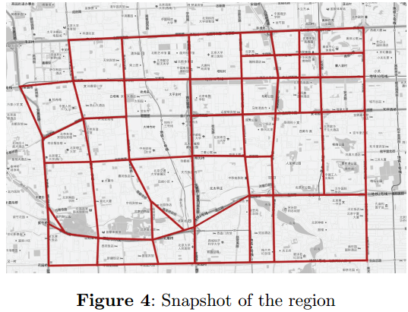
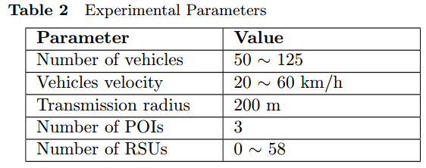
Experimental Setup
58 intersections
86 two-lane road segments
Zhang, F., Jin, B., et. al. (2012) A Content-Based Publish/Subscribe System for Efficient Event Notification over Vehicular Ad hoc Networks, UIC 2012
Notes:
The road topology used in experiments is based on a real map of ZhongGuanCun district, Beijing.
The simulation platform is NS-3, which is a famous open-source network simulator.
This table shows our experimental parameters.
The process of a data delivery experiment is designated as follows. After the experiment begins, each vehicle generates one message and randomly chooses a POI as the messages destination every other second. During the period of the whole experiment, each vehicle will send 20 messages to each POI. The experiment lasts for 1000 seconds, recording the average delivery ratio and delay of messages at the end. In the experiments, RSU-Aided Data Dissemination Mechanism is employed for data routing.

Slide 35
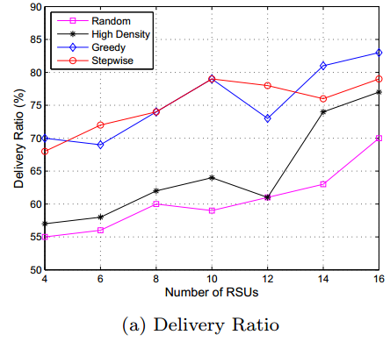
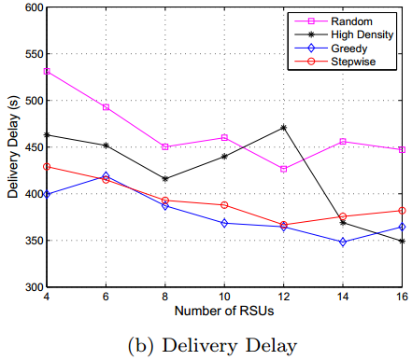
Experimental Results and Analysis -Deployment
100 vehicles
Notes:
We conduct the first group of experiments with 100 vehicles.
In general, with the increase of the number of RSUs, all the four deployment strategies can improve the delivery ratio and decrease the delay. Compared with random and high density, stepwise and greedy strategies can acquire higher delivery ratios and lower delay.

Slide 36
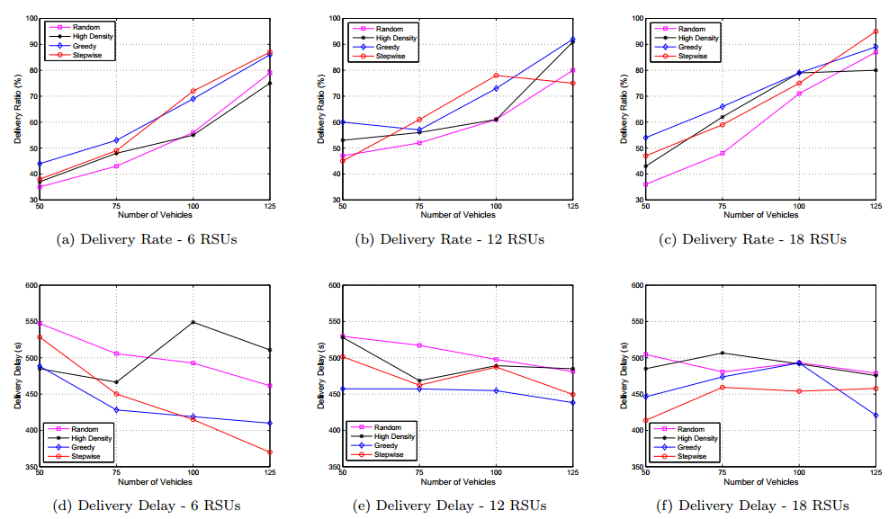
Experimental Results and Analysis -Deployment
Notes:
In the second group of experiments, we observe the effect of the number of vehicles on delivery ratio and delay under different number of RSUs (6 RSUs, 12 RSUs and 18 RSUs) deployed by the four strategies. The experimental results in figure 6 show that the stepwise and greedy strategies outperform the random and the high density.

Slide 37
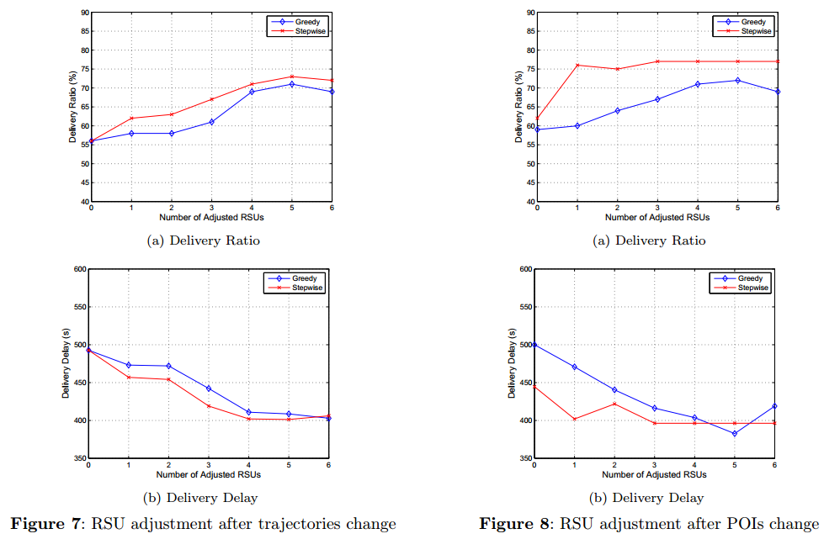
Experimental Results and Analysis -Adjustment
Notes:
In order to inspect the effectiveness of SBA and GBA after the trajectories or POIs are updated, we carry out data delivery experiments where 1 to 6 RSUs are chosen from 6 deployed RSUs and their locations are adjusted by SBA or GBA. Figure 7 and figure 8 show the experimental results after trajectories and POIs change, respectively. With the increase of the number of RSUs to be adjusted, the performances of experiments are improved.

Slide 38
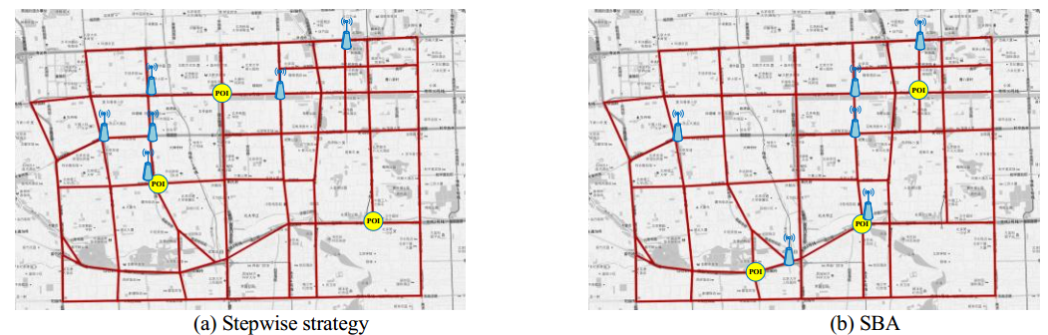
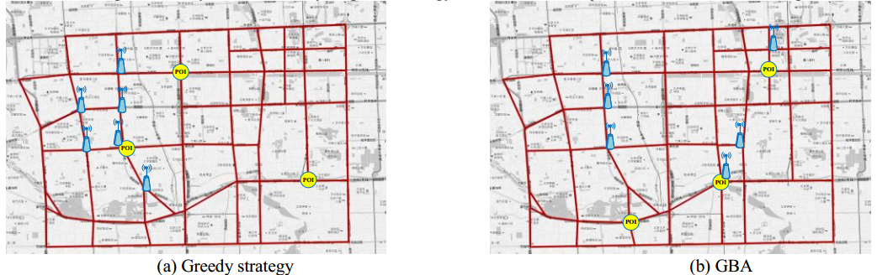
Experimental Results and Analysis -Adjustment
Fig.9 RSU layouts obtained by Stepwise strategy and SBA with 3 adjusted RSUs after POIs change
Fig. 10 RSU layouts obtained by Greedy strategy and GBA with 3 adjusted RSUs after POIs change
Notes:
In particular, Fig. 9 and fig. 10 show RSU layouts obtained by different strategies.

Slide 39
Outline
Background
1
Volans
2
Evaluation
3
Conclusion
4
Notes:
At last, let me have a brief conclusion.

Slide 40
Conclusions
Present an RSU deployment and adjustment approach, called Volans, for the POI- related applications in urban scenarios
Experimental results show that our approach can improve the performance on data delivery significantly
Future work
Analyze the effects of different data routing mechanisms on RSU deployment
Notes:
In this work, we present an RSU deployment and adjustment approach, called Volans, for the POI- related applications in urban scenarios.
In addition, experimental results show that our approach can improve the performance on data delivery significantly.
Our next work will analyze the effects of different data routing mechanisms on RSU deployment.

Slide 41

Thanks !
hujiafeng11@otcaix.iscas.ac.cn
Notes:
Thank you for your attention.

Slide 42

Q&A
Jiafeng Hu
hujiafeng11@otcaix.iscas.ac.cn

